Slide 1


Rushikesh Suryawanshi
08/12/2024

Slide 2

Outline
Executive Summary
Introduction
Methodology
Results
Conclusion
Appendix

Slide 3
Executive Summary
Summary of methodologies
Data Collection
Data Wrangling
Exploratory Data Analysis
Interactive Maps with Folium
Dashboarding using Plotly
Predictive Analysis
Summary of all results
EDA Results
Interactive Analytics
Predictive Analysis

Slide 4
Introduction
Context: SpaceX revolutionized commercial space travel by reducing costs through reusable rocket stages. The goal is to predict the reusability of the first stage, minimizing launch costs.
Research Questions:
Which factors (e.g., payload, orbit) impact landing success?
Has the success rate improved over time?
What is the optimal algorithm for binary classification?

Slide 5

Section 1

Slide 6
Methodology
Data Collection: Combined data from SpaceX's REST API and Wikipedia to gather information on launches, including flight details, payload, and outcomes.
Data Preparation: Addressed missing values and encoded outcomes for binary classification. Labeled successful landings as "1" and unsuccessful as "0."
EDA Techniques: Visualized trends and relationships between variables. SQL queries provided statistical summaries.
Interactive Tools:
Folium maps highlighted launch sites and outcomes.
Plotly Dash dashboard visualized metrics like success rates.
Predictive Modeling: Trained and evaluated classifiers (Logistic Regression, Decision Trees, SVM, KNN) using GridSearchCV for parameter tuning.

Slide 7
Data Collection
Data was collected with two methods from Scrapping the Web (Wikipedia) and from SpaceX’s REST APIs
You need to present your data collection process use key phrases and flowcharts

Slide 8
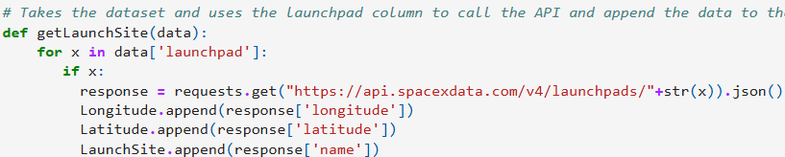
Data Collection – SpaceX API
Data was collected by calling SpaceX’s API
Reference:
https://github.com/rushikeshssuryawanshi/Data-Science/blob/main/Data%20Collection%20API.ipynb

Slide 9
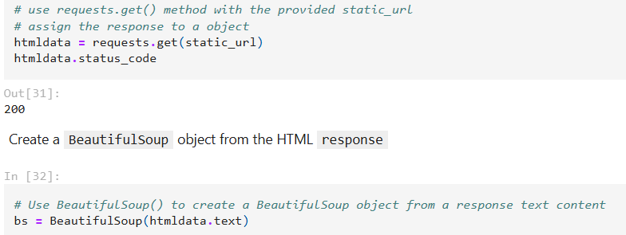
Data Collection - Scraping
Data was collected using Wikipedia’s webpage. Here, we use the HTTP get request to get data from the page. Using requests.get() and then usingBeautifulSoup
Reference: https://github.com/rushikeshssuryawanshi/Data-Science/blob/main/Data%20Collection%20with%20Web%20Scraping.ipynb

Slide 10
Data Wrangling
This is a process to convert raw data into interpretable data.
In this section, Data Analysis was carried out in which I calculated the number of launches, number of launches and occurrences of each orbit, etc.
Reference: https://github.com/rushikeshssuryawanshi/Data-Science/blob/main/Data%20Wrangling.ipynb

Slide 11
EDA with Data Visualization
Exploratory Data analysis is done so that we get an initial idea on how our data is distributed, what are the challenges we might face, for e.g. which columns needs to be neglected, which features have a lot of outliers, what features need the null values to be imputed with mean or any other statistical value, standardization and normalization to be done, etc. This is done by histograms, boxplots, statistical summaries, etc.
Reference: https://github.com/rushikeshssuryawanshi/Data-Science/blob/main/EDA%20with%20Data%20Visualization.ipynb

Slide 12
EDA with SQL
EDA with SQL can be done by querying the tables. The csv file is converted into a sql table with df.to_sql function then the table can be used to get many insights form the data.
Reference: https://github.com/rushikeshssuryawanshi/Data-Science/blob/main/EDA%20with%20sqllite.ipynb

Slide 13
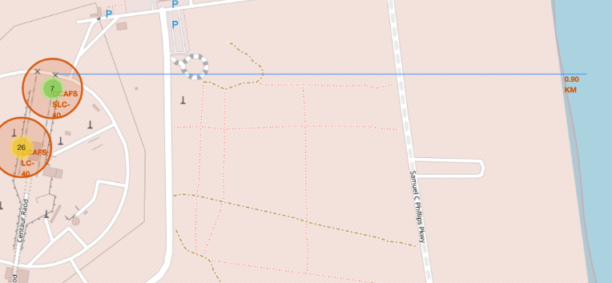
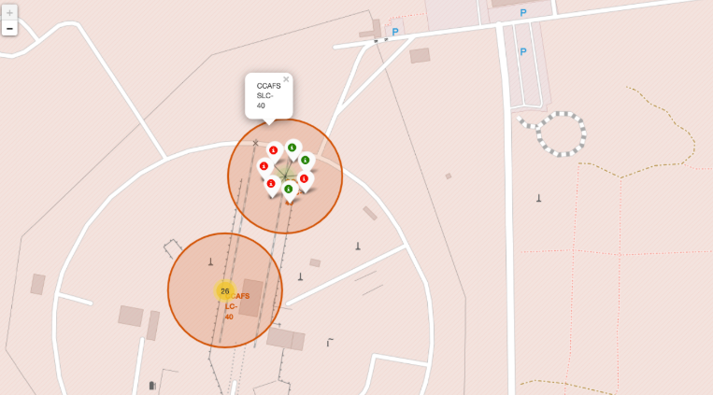
Build an Interactive Map with Folium
Folium is a module used to give interactive geographical insights.
I marked the Launch sites on the map, I also learned to mark the successful and failed launches from a particular launch sites.
Reference: https://github.com/rushikeshssuryawanshi/Data-Science/blob/main/Interactive%20Visual%20Analytics%20with%20Folium.ipynb

Slide 14
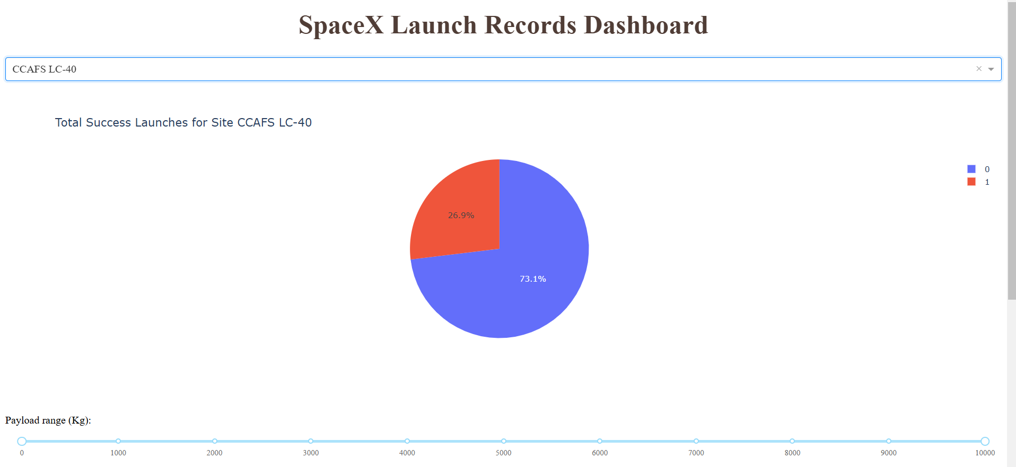
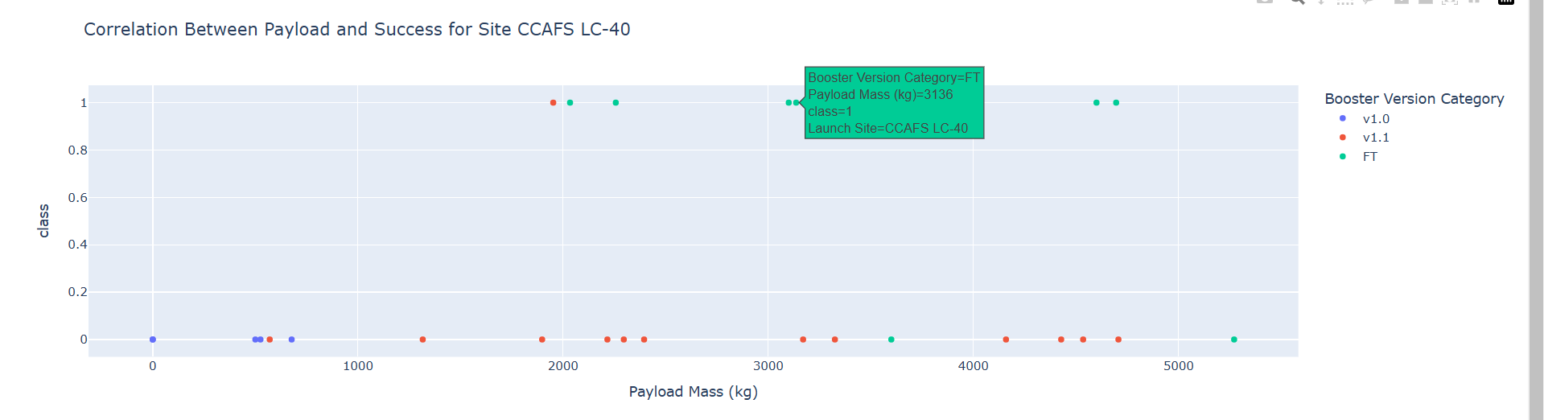
Build a Dashboard with Plotly Dash
We use the Dash utility to create interactive dashboards.
Reference: https://github.com/rushikeshssuryawanshi/Data-Science/blob/main/spacex_dash_app.py

Slide 15
Predictive Analysis (Classification)
Modeling Outcomes: Decision Trees emerged as the most accurate algorithm, achieving superior metrics like F1 and accuracy scores.

Slide 16
Results
Decision Trees are the most suitable predictive model.
Launch success improves with lower payloads and over time.
Proximity to the equator and coastlines enhances site efficiency.
Specific orbits (e.g., GEO, HEO) have perfect success rates.
KSC LC-39A leads in launch success among sites.

Slide 17


